Slide 1
Matrix-Chain Multiplication
Given: “chain” of matrices (A₁, A₂, . . . An), with A_{i} having dimension
(p_{i−1} × p_{i}).
Goal: compute product A₁ · A₂ · · · An as quickly as possible
1

Slide 2
Multiplication of (p × q) and (q × r) matrices takes pqr steps
Hence, time to multiply two matrices depends on dimensions! Example:: n = 4. Possible orders:
(A₁(A₂(A₃A₄)))
(A₁((A₂A₃)A₄))
((A₁A₂)(A₃A₄))
((A₁(A₂A₃))A₄)
(((A₁A₂)A₃)A₄)
Suppose A₁ is 10 × 100, A₂ is 100 × 5, A₃ is 5 × 50, and A₄ is 50 × 10
Order 2:
100 · 5 · 50 + 100 · 50 · 10 + 10 · 100 · 10 = 85, 000
Order 5:
10 · 100 · 5 + 10 · 5 · 50 + 10 · 50 · 10 = 12, 500
But: the number of possible orders is exponential!
1

Slide 3
We want to find Dynamic programming approach to optimally solve this problem
The four basic steps when designing DP algorithm:
Characterize structure of optimal solution
Recursively define value of an optimal solution
Compute value of optimal solution in bottom-up fashion
Construct optimal solution from computed information
1

Slide 4
1. Characterizing structure
Let A_{i,j} = A_{i} · · · A_{j} for i ≤ j.
If i < j, then any solution of A_{i,j} must split product at some k, i ≤ k < j, i.e., compute A_{i,k}, A_{k+1,j}, and then A_{i,k} · A_{k+1,j}.
Hence, for some k, cost is
cost of computing A_{i,k} plus
cost of computing A_{k+1,j} plus
cost of multiplying A_{i,k} and A_{k+1,j}.

Slide 5
Optimal (sub)structure:
Suppose that optimal parenthesization of A_{i,j} splits between A_{k}
and A_{k+1}.
Then, parenthesizations of A_{i,k} must be optimal, too
^{and A}k+1,j
(otherwise, enhance overall solution — subproblems are indepen- dent!).
Construct optimal solution:
split into subproblems (using optimal split!),
parenthesize them optimally,
combine optimal subproblem solutions.
5

Slide 6
2. Recursively def. value of opt. solution
Let m[i, j] denote minimum number of scalar multiplications needed to compute A_{i,j} = A_{i} · A_{i+1} · · · A_{j} (full problem: m[1, n]).
Recursive definition of m[i, j]:
if i = j, then
m[i, j] = m[i, i] = 0
(A_{i,i} = A_{i}, no mult. needed).
if i < j, assume optimal split at k, i ≤ k < j. is p_{i−1} × p_{k} and
^{A}i,k
^{A}k+1,j
is p_{k} × p_{j}, hence
m[i, j] = m[i, k] + m[k + 1, j] + p_{i−1} · p_{k} · p_{j}.
We do not know optimal value of k, hence
_{ 0}
if i = j
if i < j
m[i, j] = min
i≤k<j
{m[i, k] + m[k + 1, j]


+p_{i−1} · p_{k} · p_{j}}
5

Slide 7
We also keep track of optimal splits:
s[i, j] = k ⇔ m[i, j] = m[i, k] + m[k + 1, j] + p_{i−1} · p_{k} · p_{j}
5

Slide 8
3. Computing optimal cost
Want to compute m[1, n], minimum cost for multiplying A₁ · A₂ · · · An.
Recursively, according to equation on last slide, would take Ω(2^{n})
(subproblems are computed over and over again).
However, if we compute in bottom-up fashion, we can reduce run- ning time to poly(n).
Equation shows that m[i, j] depends only on smaller subproblems:
for k = 1, . . . , j − 1,
A_{i,k} is product of k − i + 1 < j − i + 1 matrices,
^{A}k+1,j
is product of j − k < j − i + 1 matrices.
Algorithm should fill table m using increasing lengths of chains.
5

Slide 9
The Algorithm
1: n ← length[p] − 1 2: for i ← 1 to n do 3: m[i, i] ← 0
4:
5:
6:
7:
8:
9:
10:
11:
12:
13:
14:
15:
16:
17:
end for
for l ← 2 to n do
for i ← 1 to n − l + 1 do
j ← i + l − 1
m[i, j] ← ∞
for k ← i to j − 1 do
q ← m[i, k] + m[k + 1, j] + p_{i−1} · p_{k} · p_{j}
if q < m[i, j] then
m[i, j] ← q
s[i, j] ← k
end if end for
end for end for
5

Slide 10
Example
A₁ (30 × 35), A₂ (35 × 15), A₃ (15 × 5), A₄ (5 × 10), A₅ (10 × 20),
A₆ (20 × 25)
Recall: multiplying A (p × q) and B (q × r) takes p · q · r scalar multi- plications.
i
1
2
3
4
5
6
6
5
4
j
3
2
1
 |  |  |  |  | 0
 |  |  |  | 0
 |  |  | 0
 |  | 0
 | 0
0

Slide 11
Example
A₁ (30 × 35), A₂ (35 × 15), A₃ (15 × 5), A₄ (5 × 10), A₅ (10 × 20),
A₆ (20 × 25)
Recall: multiplying A (p × q) and B (q × r) takes p · q · r scalar multi- plications.
i
1
2
3
4
5
6
6
5
4
j
3
2
1
15,125 | 10,500 | 5,375 | 3,500 | 5,000 | 0
11,875 | 7,125 | 2,500 | 1,000 | 0
9,375 | 4,375 | 750 | 0
7,875 | 2,625 | 0
15,750 | 0
0

Slide 12
4. Constructing optimal solution
Simple with array s[i, j], gives us optimal split points.
Complexity
We have three nested loops:
l, length, O(n) iterations
i, start, O(n) iterations
k, split point, O(n) iterations
Body of loops: constant complexity.
Total complexity: O(n³)

Slide 13
All-pairs-shortest-paths
Directed graph G = (V, E), weight function
w : E → IR, |V | = n
Weight of path p = (v₁, v₂, . . . , v_{k}) is w(p) =
Σ
k−1
w(v , v )
i=1
i i+1
Assume G contains no negative-weight cycles
Goal: create n×n matrix of shortest path distances δ(u, v), u, v ∈ V
1st idea: use single-source-shortest-path alg (i.e., Bellman-Ford); but it’s too slow, O(n⁴) on dense graph

Slide 14
Adjacency-matrix representation of graph:
n × n adjacency matrix W = (w_{ij}) of edge weights
assume
 0 if i = j
w = weight of (i, j) if i /= j and (i, j) ∈ E
ij


∞ if i /= j and (i, j) /∈ E
In the following, we only want to compute lengths of shortest paths, not construct the paths.

Slide 15
Dynamic programming approach, four steps:
1. Structure of a shortest path: Subpaths of shortest paths are shortest paths.
Lemma. Let p = (v₁, v₂, . . . , v_{k}) be a shortest path from v₁ to v_{k}, let
p_{ij} = (v_{i}, v_{i+1}, . . . , v_{j}) for 1 ≤ i ≤ j ≤ k be subpath from v_{i} to v_{j}. Then,
^{p}ij
is shortest path from v_{i} to v_{j}.
Proof. Decompose p into
v₁ ~ v_{i} ~ v_{j} ~ v_{k}.
Then, w(p) = w(p_{1i}) + w(p_{ij}) + w(p_{jk}). Assume there is cheaper p^{j}_{ij}
from v_{i} to v_{j} with w(p_{i}^{j}_{j}) < w(p_{ij}). Then
^{pj}ij
^{p}1i
^{p}ij ^{p}jk
v₁ ~ v_{i} ~ v_{j} ~ v_{k}
is path from v₁ to v_{k} whose weight w(p_{1i}) + w(p^{j}_{ij}) + w(p_{jk}) is less than
w(p), a contradiction.
^{p}1i
^{p}jk

Slide 16
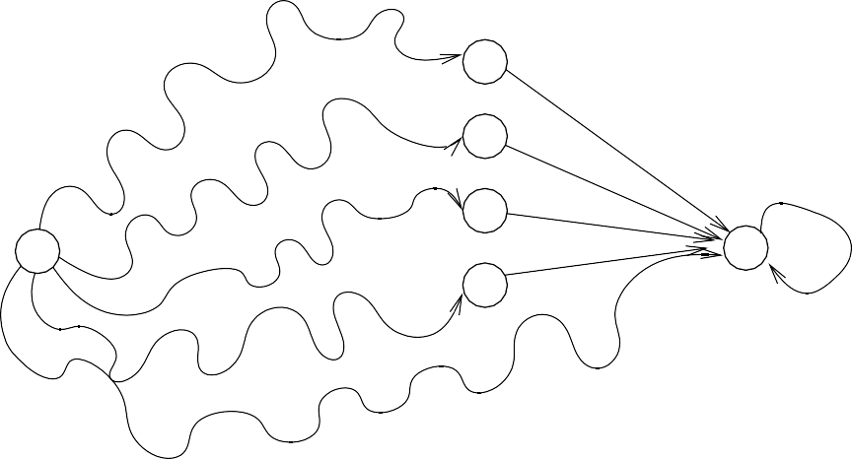
2. Recursive solution and 3. Compute opt. value (bottom-up)
Let d^{(m)} = weight of shortest path from i to j that uses at most m
ij
edges.
( ₀
_{d}(0)
=
if i = j
ij
∞ if i /= j
_{d}(m)
= min d
(m−1)
+ w
ij
k
ik
kj
at most m−1 edges
k’s
i
j
at most m−1 edges
We’re looking for δ(i, j) = d
(n−1)
= d
(n)
ij
= d
(n+1)
ij
= · · ·
ij

Slide 17
Alg. is straightforward, running time is O(n⁴) (n − 1 passes, each
computing n² d’s in Θ(n) time)
Unfortunately, no better than before. . .
Approach is similar to matrix multiplication:
C = A · B, n × n matrices, c_{ij} = ^{Σ}_{k} a_{ik} · b_{kj}, O(n³) operations Replacing “ +” with “ min” and “·” with “ +” gives
c = min{a + b },
ij ik
kj
k
very similar to
d
(m)
ij
= min{d
(m−1)
+ w }
k
ik
kj
Hence D^{(m)} = D^{(m−1)} “ ×” W.

Slide 18
Floyd-Warshall algorithm
Also DP, but faster (factor log n)
Define c^{(m)} = weight of a shortest path from i to j with intermediate
ij
vertices in {1, 2, . . . , m}.
Then δ(i, j) = c^{(n)}
ij

Slide 19
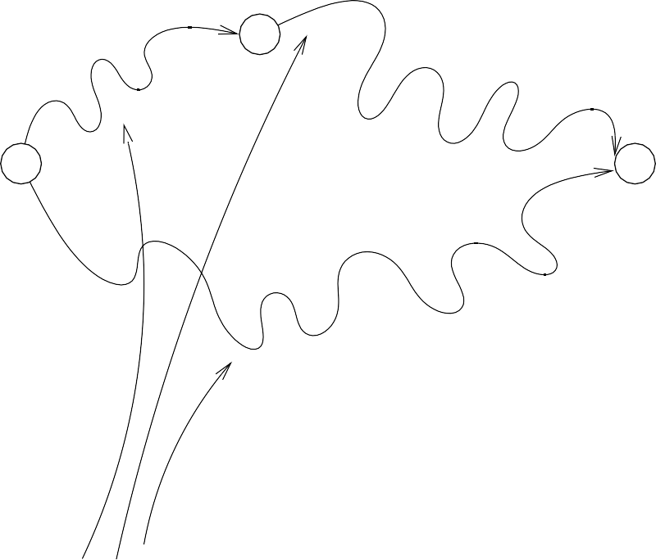
Compute c^{(n)} in terms of smaller ones, c^{(<n)}:
ij ij
_{c}(0)
=
ij
^{w}ij
_{c}(m)
= min c
(m−1)
,
(m−1)
+ c
(m−1)
ij
ij
^{c}im
mj
(m−1)
c
im
(m−1)
^{c} mj
m
i
j
c
(m−1)
ij
intermediate vertices in {1,...,m−1}

Slide 20
Difference from previous algorithm: needn’t check all possible in- termediate vertices. Shortest path simply either includes m or doesn’t.
Pseudocode:
for m ← 1 to n do for i ← 1 to n do
for j ← 1 to n do
if c_{ij} > c_{im} + c_{mj} then
^{c}ij ^{← c}im ^{+ c}mj
end if
end for end for
end for
Superscripts dropped, start loop with c_{ij} = c^{(m−1)}, end with c_{ij} = c^{(m)}
ij ij
Time: Θ(n³), simple code

Slide 21
Best algorithm to date is O(V ² log V + V E)
Note: for dense graphs (|E| ≈ |V |²) can get APSP (with Floyd- Warshall) for same cost as getting SSSP (with Bellman-Ford)! (Θ(V E) = Θ(n³))

